Slide 1
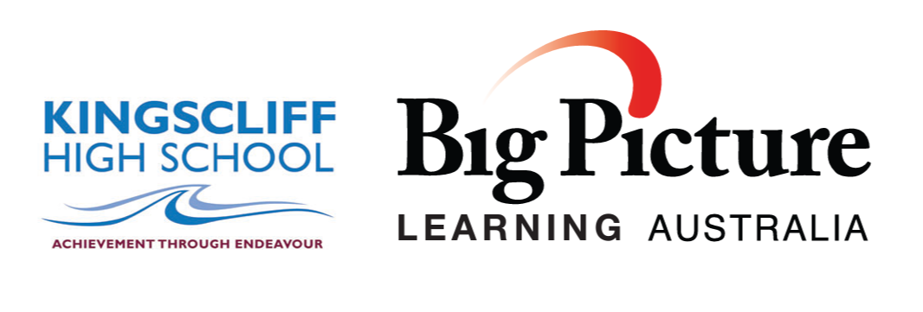
A New Design for Learning

Slide 2
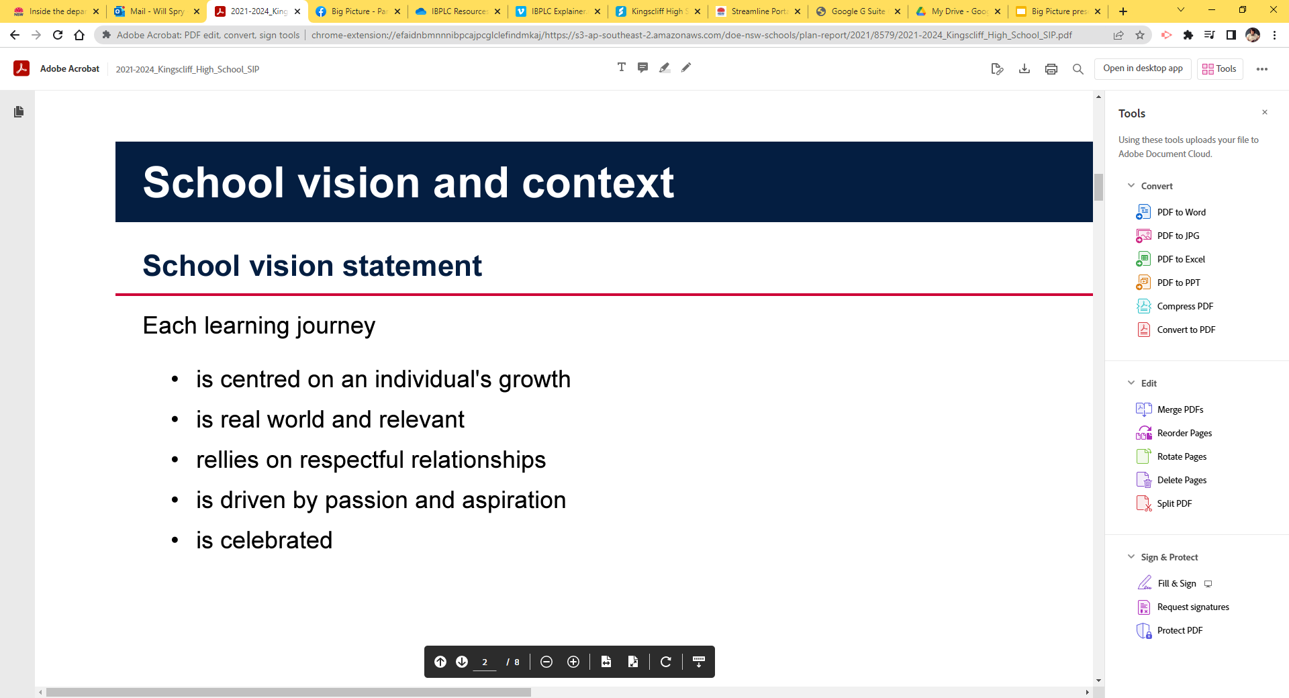
is centered on an individual’s growth.

Slide 3
is centered on an individual’s growth.
is real world and relevant.

Slide 4
is centered on an individual’s growth.
is real world and relevant.
relies on respectful relationships.

Slide 5
is centered on an individual’s growth.
is real world and relevant.
relies on respectful relationships.
is driven by passion and aspiration.

Slide 6
Big Picture Education Distinguishers

Slide 7
1. Academic rigour: Head, heart and hand
Big Picture schools have a strong intellectual purpose for each and every student. Students are continually challenged to deepen their learning and improve their performance across five learning goals: quantitative reasoning, empirical reasoning, social reasoning, communication skills and personal qualities. A high standard of academic work is expected of all students.

Slide 8
2. Leaving to learn: Learning through internships
Students work two days a week in an interest-based internship with a mentor from the community on an intellectually rigorous real-world project that is connected to their learning goals.

Slide 9
3. Personalisation: One student at a time
With the help of the advisory teacher and parents, each student develops a learning plan that explores their interests and passions, and identifies personal learning goals, authentic project work and wider curriculum requirements. This plan is reviewed and updated regularly.

Slide 10
4. Authentic assessment
Each term the students exhibit their portfolios of work to a panel made up of the advisory teacher, family, peers, the mentor, and others from the community. They provide evidence of progress against their learning goals and they reflect on the process of their learning.

Slide 11
5. Collaboration for learning
Students work in one-on-one or small group learning environments around their interests both inside and outside the school. Through internships, the community plays an integral role in the education of the students.

Slide 12
6. Learning in advisory
Students are in an advisory group of no more than 17 students and an advisory teacher. They stay in the same advisory for much of their secondary education. The advisory teacher manages each student's learning plan and ensures that all learning goals and the National Curriculum are covered.

Slide 13
7. Trust, respect and care
One of the striking things about Big Picture schools is the ease with which students interact with adults in both the school and the wider community. A culture of trust, respect and care is shared between students and adults, as well as among students themselves.

Slide 14
8. Everyone's a leader
In Big Picture Schools, leadership is shared among the principal, staff, students, family, and community partners. Opportunities for leadership are created for everyone.

Slide 15
9. Families are enrolled too
Big Picture schools aim for real family engagement. Parents or carers are regarded as essential members of the learning team, beginning with the application process and progressing through to learning plan development, exhibitions and graduation.

Slide 16
10. Creating futures
All students are expected to graduate from school to further learning. They are prepared for, and connected to, opportunities for learning at university and/or other further education.

Slide 17
11. Teachers and leaders are learners too
New ideas constantly emerge as part of the learning cycle process. Teachers and leaders in Big Picture schools and programs regularly attend to new ideas and learn new ways of working. They develop reflective practice and find ways of sharing this learning with others.

Slide 18
12. Diverse and enduring partnerships
A Big Picture School has a strong focus on building and creating external partnerships. These include partnerships with: the family, mentors, local councils, businesses, universities, TAFE colleges and other training providers. These partnerships give students the opportunities to pursue their learning and achieve their goals.

Slide 19
How. Does. It. Work?

Slide 20
Regular school structure.
Mandatory and Elective Subjects Set and designed by NESA (NSW Education Standards Authority).
Teachers teach to the curriculum and asses students against set outcomes.
Students move between 7 individual subjects and 7 teachers
5 x 60min lessons per day.

Slide 21
Big picture structure.
Students select area of interest for each term.
Teachers work with students to design a learning plan that incorporates established learning goals.
Students work individually within a set group with a mentor teacher in an Advisory.
Pending availability, 1 Regular elective can be accessed within the school environment at grade level or above with agreement from specialist teachers.
Students learn 2 days per week outside of school in an internship.

Slide 22
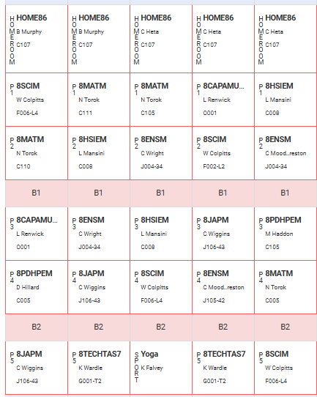
Current School Format
Roll Call to start the day.
5 60 min lessons of Mandatory and elective subjects per day.
Sport Wednesday afternoon

Slide 23
Big Picture Format
Homeroom
Homeroom
Homeroom
Homeroom
Homeroom
Daily Home room lesson
Set goals for the day
Individual work + Explicit teaching.
Internship days experience practical learning.
End of term exhibition of learning.
Advisory
Lesson
Advisory
Lesson
Advisory
Lesson
Advisory
Lesson
Advisory
Lesson
Advisory
Lesson
Advisory
Lesson
Advisory
Lesson
Advisory
Lesson
Internship (LTI)
Advisory
Lesson
Advisory
Lesson
Advisory
Lesson
Internship (LTI)
Sport
Teacher visit
at least once
per term.
Teacher visit
at least once
per term.
Advisory
Lesson
Advisory
Lesson

Slide 24
Homeroom
Homeroom
Homeroom
Homeroom
Homeroom
Advisory
Lesson
Advisory
Lesson
Advisory
Lesson
Advisory
Lesson
Advisory
Lesson
Advisory
Lesson
Advisory
Lesson
Advisory
Lesson
Advisory
Lesson
Internship (LTI)
Advisory
Lesson
Advisory
Lesson
Advisory
Lesson
Internship (LTI)
Sport
Teacher visit
at least once
per term.
Teacher visit
at least once
per term.
Advisory
Lesson
Advisory
Lesson

Slide 25
What stays the same?
Still a KHS student, Camps, Sport, Year Assemblies and Presentations remain.
Daily schedule and breaks are the same as the rest of the school.
School leadership positions are available and encouraged.
They will graduate year 12 and attend formal as a part of their year group.

Slide 26

Leaving the “mainstream” curriculum.

Slide 27
Leaving the “mainstream” curriculum.
You will no longer receive a ROSA in year 10.
You will not be eligible for an ATAR.
You will no longer be enrolled in individual subjects and be taught by specialist teachers.
Elective subjects are available subject to availability. They can be a part of a students learning plan.

Slide 28
Students Graduate Yr12 with the IBPLC
(International Big Picture Learning Credential)
Student final year results are presented in a Learner Profile that is a showcase of a graduate’s attainments, backed up by evidence of their work that students curate in a interactive online portfolio. The Learner Profile is personalised and designed to reflect the richness of students’ real-world experiences, personal qualities and academic results.

Slide 29
The IBPLC pathway to university
The International Big Picture Learning Credential (IBPLC) offers a rigorous non-ATAR pathway from secondary to tertiary study that is currently accepted by 18 universities around Australia, including the Australian National University (ANU) and the University of Technology Sydney (UTS).
The credential was developed in collaboration with Melbourne Metrics at the University of Melbourne and is warranted by the same. It is hosted on the Universities Admissions Centre platform Credfolio.

Slide 30
Australian National University
Avondale University
Charles Sturt University
Flinders University
Griffith University
La Trobe University
Murdoch University
RMIT University
Southern Cross University
University of New England
University of Newcastle
University of Tasmania
University of Technology Sydney
University of Wollongong
Victoria University
Western Sydney University
Swinburne University
University of Canberra
The University of Sydney and The University of New South Wales are currently in negotiations to become partner universities with BPLA.

Slide 31
Fees.
$4.50 per week, $45 per term, $180 per year.
1 whole faculty excursion per term.
Equipment and facilities.
Materials for class activities.
Group celebration days.
General expenses.

Slide 32
Big Picture will ask.
Are you ready to grow as a learner?
Are you willing to experience real-world learning?
Are you here to develop new relationships?
Are you passionate about working and learning in a new way?
Are you open to share your learning with your community?

Slide 33
The Learning Goals
Instead of working to a set curriculum we use the learning goals to plan our learning experiences.
The six learning goals frame the learning progression in years 9-12.
In year 11 and 12 the learning goals become the framework for assessment.

Slide 34
The Learning Goals
The Learning Goals allow Big Picture to be a true alternative to the mainstream curriculum.
Without the Learning Goals we are a Work Experience program.

Slide 35
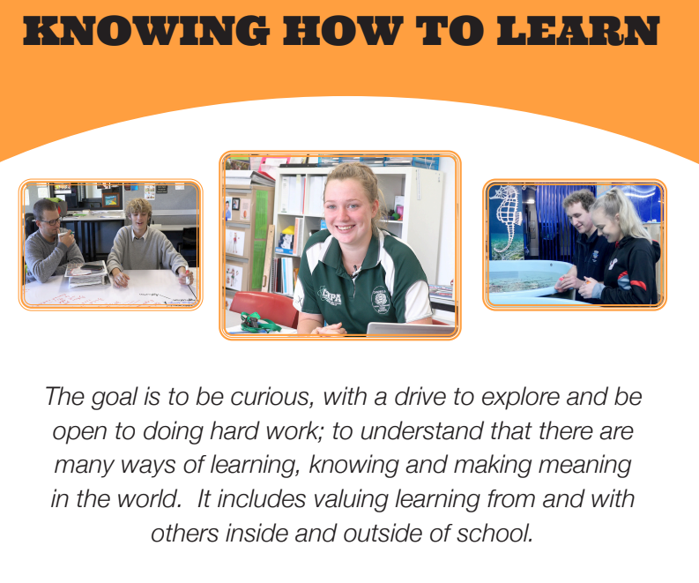

Slide 36
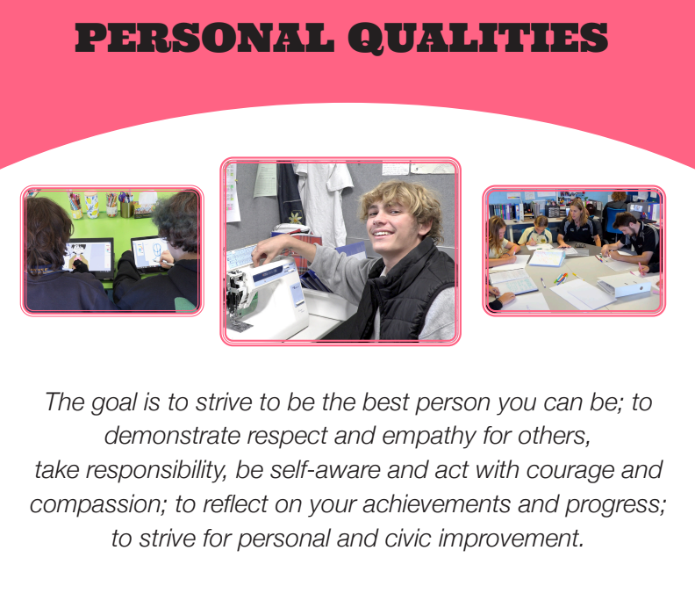

Slide 37
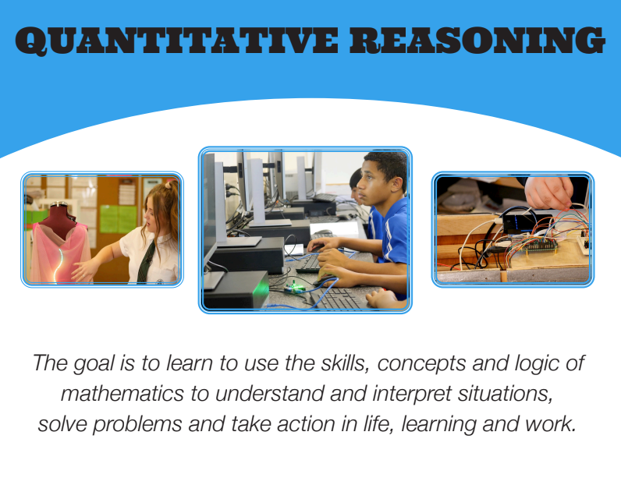

Slide 38
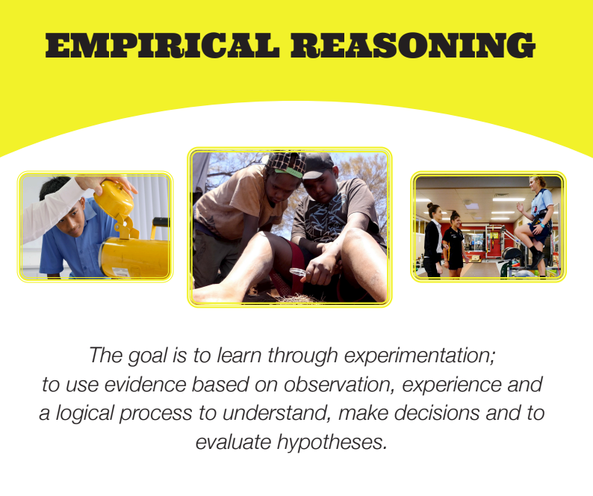

Slide 39
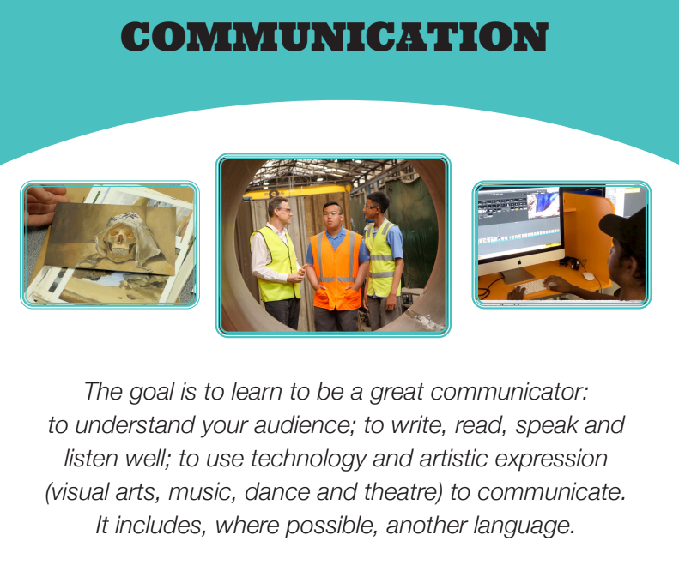

Slide 40
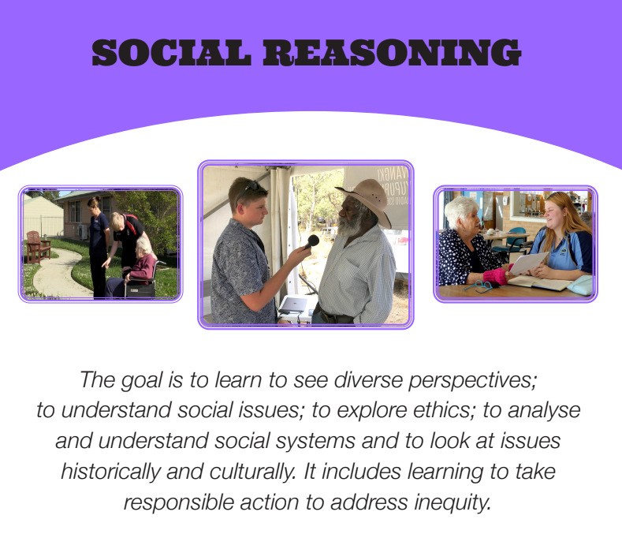

Slide 41
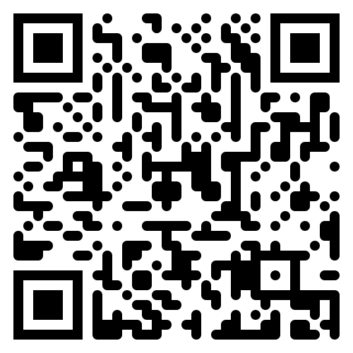

Slide 42
Some core values.

Slide 43
The role of the Advisory teacher is that of a generalist who guides students, helps them to develop their ideas, provides feedback and support, connects them to people and places related to their interests, helps them to build specific knowledge, and explicitly teaches the group independent learning skills.

Slide 44
Advisors, students, mentors and family identify and celebrate growth with the understanding that all students progress individually.

Slide 45
The focus is individual growth.
The measure is to look at where a student was last week, last term and last year.

Slide 46
Students have access to TAFE, Traineeships, University entry courses and school-based apprenticeships as a part of their Big Picture learning (15yrs+ and pending availability)

Slide 47
Students are strongly encouraged to incorporate ongoing internships and external mentoring into their learning. This can be 2 days per week or as a part of a block within a term depending on suitability. Students can travel and board for internships pending suitability.

Slide 48
Year 11 students can enrol in HSC courses and sit HSC exams as a part of their learning plan.

Slide 49
Students graduate from Big Picture with a credential and learning portfolio, qualifying and preparing them for acceptance at a list of Australian universities. (Other University entry-qualifying courses are available as well)

Slide 50
Students can reach depths of learning in specific subjects at high school that is often not reached until university.

Slide 51
Attend school and uphold the school values.
Value and support members of your advisory.
Journal 3 times a week and read at least 1 book per term.
Create and regularly update an online personal profile.
Create a personal profile video.
Complete a project each term.
Engage in out learning activities.
Call and email and interview potential mentors in the community and around the world.
Big Picture Work

Slide 52
How do we apply?

