Slide 1
Big Picture 2023 - A new design for learning
ITS COMING….

Slide 2
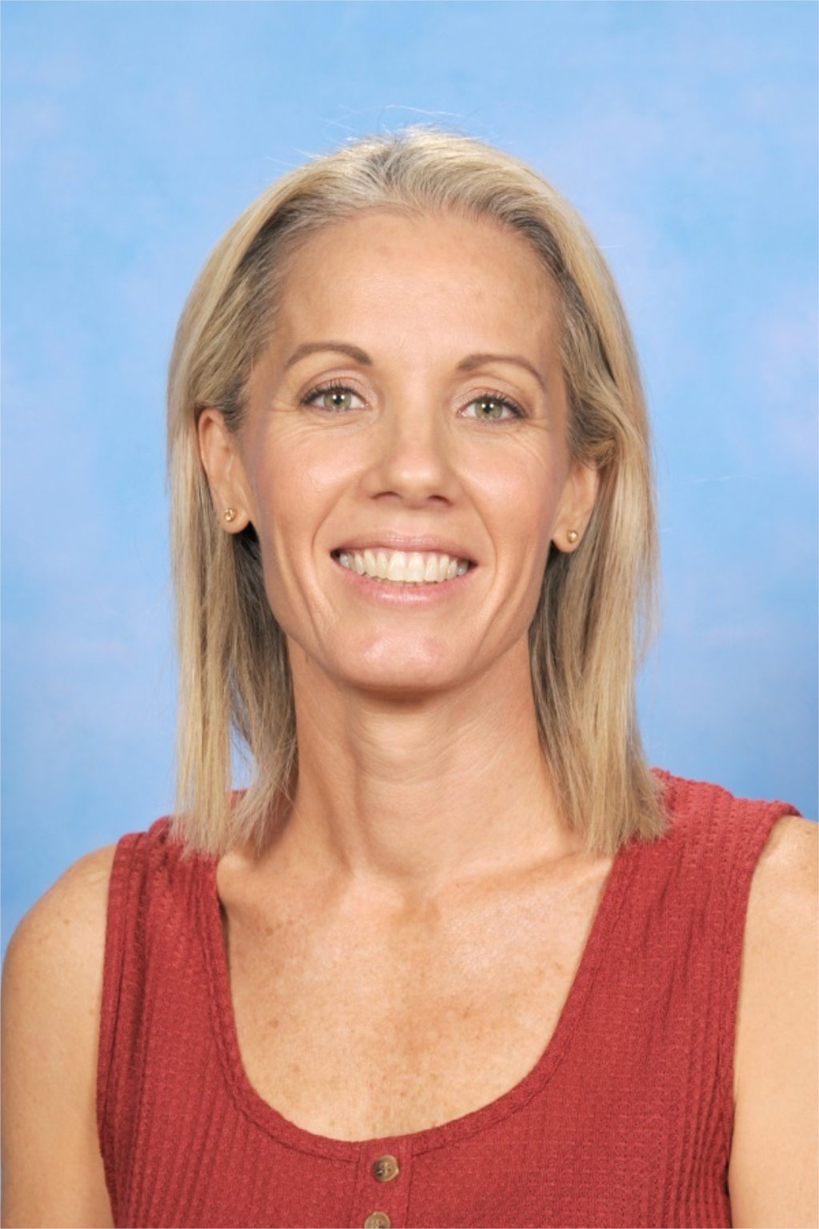
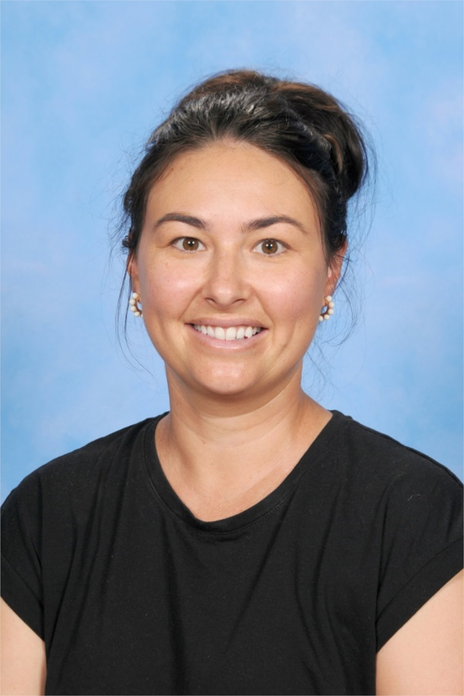
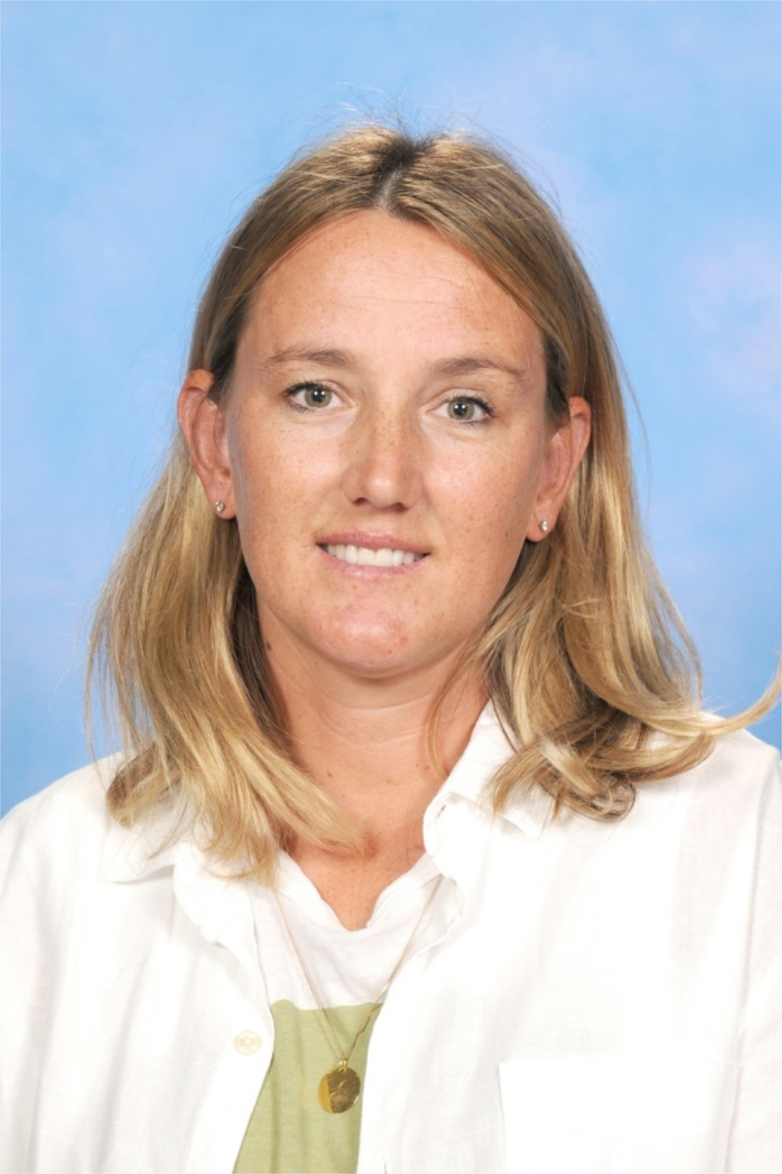
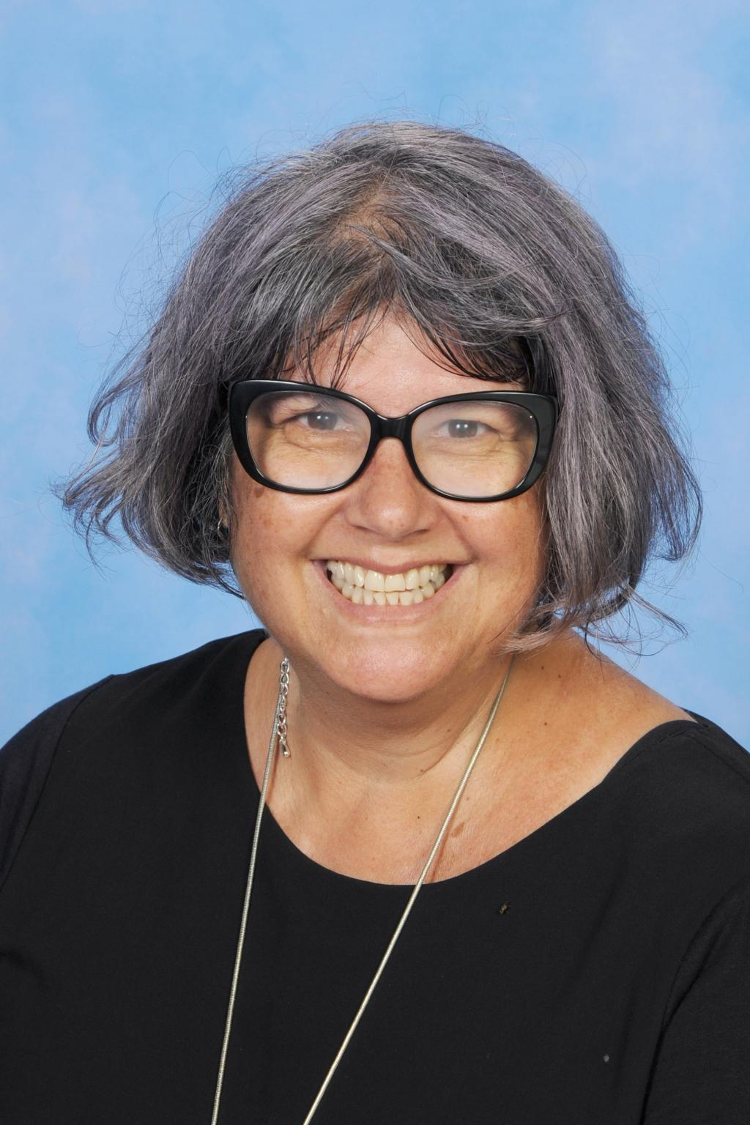
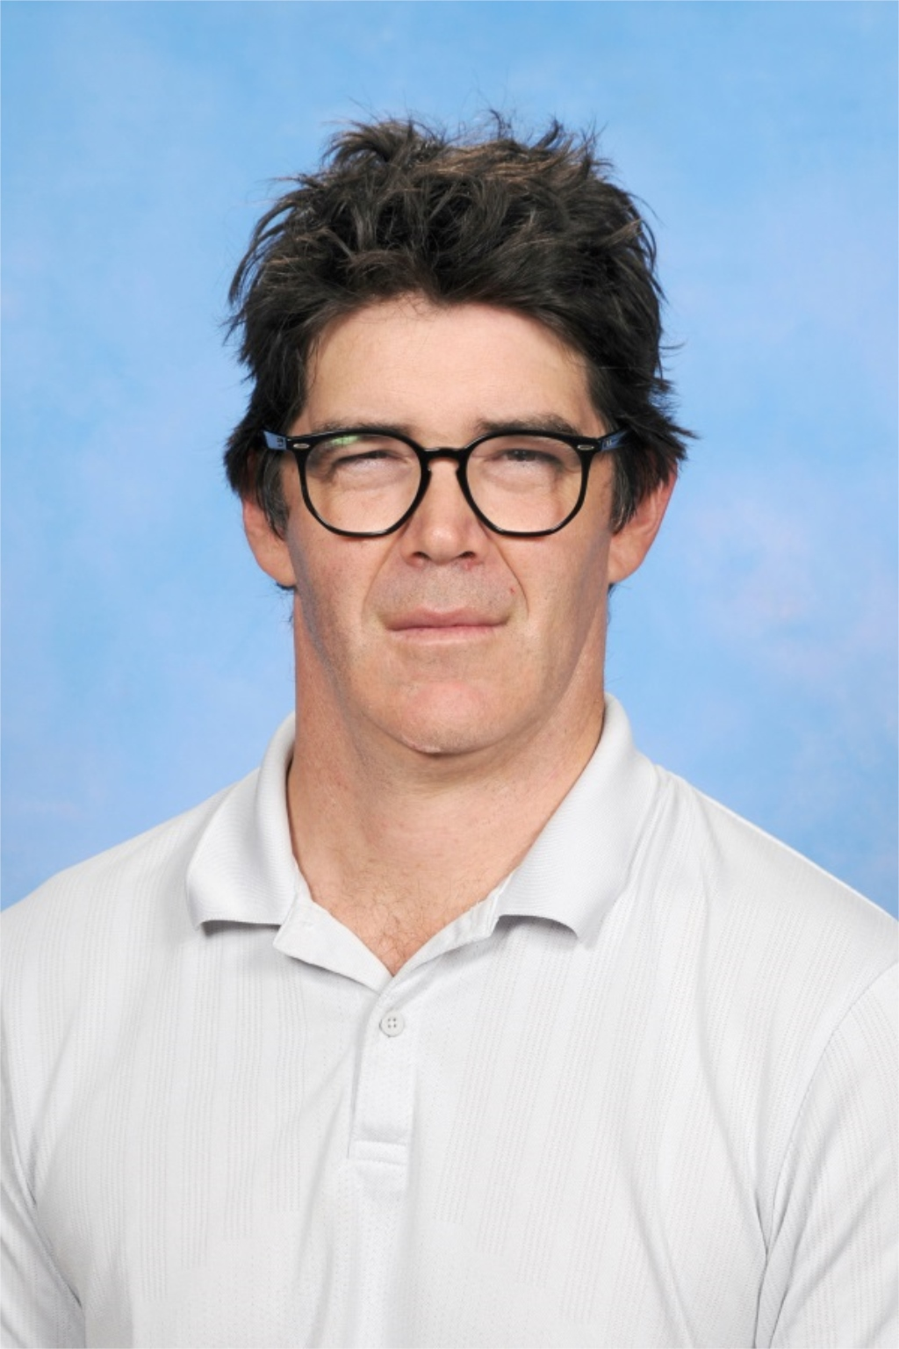
The Team

Slide 3
What is Big Picture?
Centred on individual growth
Real world and relevant
Relies on respectful relationships
Is driven by passion and aspiration
https://www.bigpicture.org.au/file/big-picture-learning-design-everyone
Notes:
Students don’t all learn the same way
That students have passions and interests they want to pursue
We need to change our style of teaching as the traditional style doesn’t suit everyone
(as I am sure it didn’t suit some of you)

Slide 4
Regular School Structure
Mandatory and Elective Subjects Set and designed by the Department of Education.
Teachers teach to the curriculum and assess students against set outcomes.
Students move between 7 individual subjects and 7 teachers
4x 80 min lessons per day.
Notes:
The way the department is currently structured doesn’t give us much room to move…

Slide 5
Big Picture Structure
Students select area of interest for each term.
Teachers work with students to design a learning plan
Students work individually within a group of 20 with a mentor in an Advisory
Regular electives can be accessed within the school environment at grade level or above with agreement from specialist teachers.
Students work 2 days per week outside of school in an internship.
Notes:
Students select area of interest for each term.
Teachers work with students to design a learning plan that incorporates established learning goals.
Students work individually within a group of 20 with a mentor teacher in an Advisory
Students work 2 days per week in out of school

Slide 6
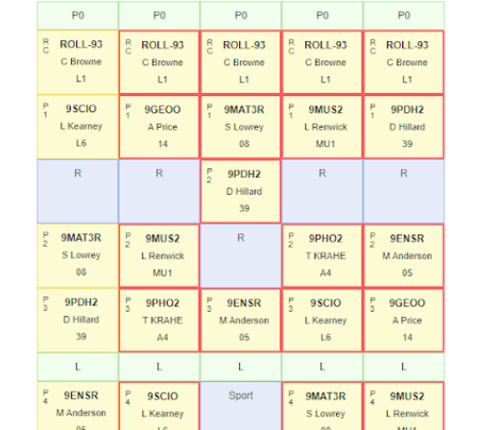
Current Daily School Structure
Roll Call to start the day
4 lessons of Mandatory and elective subjects per day
Sport Wednesday afternoons

Slide 7
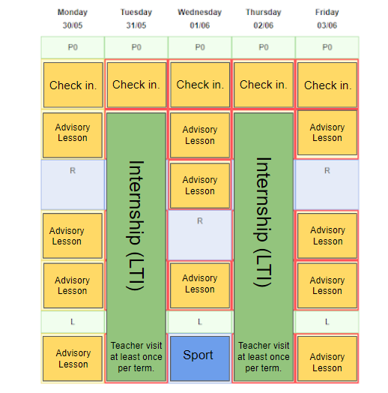
Daily Structure of BP
Daily Check in
Set goals for the day
In school days work on project/intensive literacy/numeracy
Internship days experience practical learning.
End of term presentation
https://www.bigpicture.org.au/file/lachies-internship-aged-care

Slide 8
Regular Classroom Spaces

Slide 9
Advisory Spaces

Slide 10
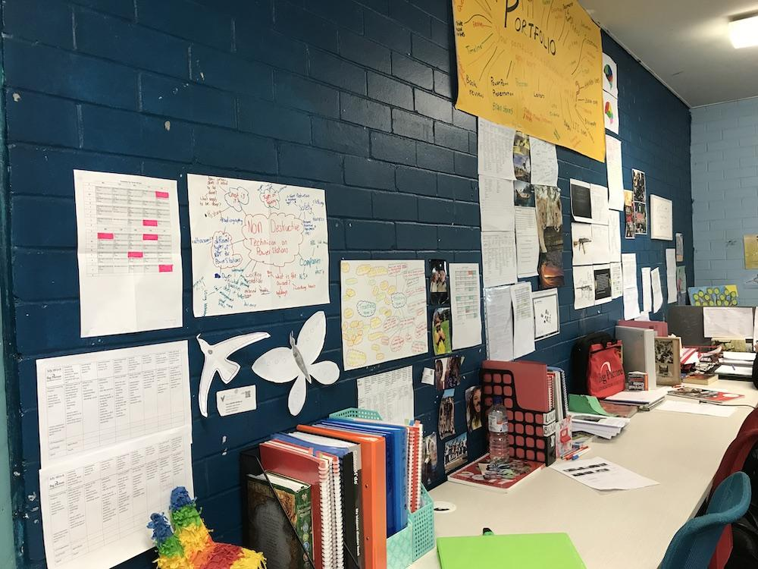

Slide 11
EOI Process
Students learn about Big Picture
Opportunity for a second info session
Application process
Parents/students receive a letter to notify them if they’ve been accepted

